Slide 1
MINI PROJECT TITLE EVALUATION
BY- Mini Project Group (DSE 9)
Project Group – Prof.Lalit Bhoye

Slide 2
GROUP MEMEBER
Mini Project Group - DSE 9
SR NO. | NAME OF STUDENT | TUF ID | ROLL NO.
1. | Abdul Ahad Aziz Rakhangi | TU5S2021035 | 91
2. | Ashley Dominic | TU5S2021036 | 92
3. | Rutuja Anil Deshmukh | TU5S2021037 | 93
4. | Kushi Sameer Khan | TU5S2021038 | 94

Slide 3
INDIVIDUAL PROJECT TOPICS
AHAD AZIZ RAKHANGI (B91)Traffic | ASHLEY DOMINIC (B92)
Solar mobile charger | Rocker boggie robot
Floor cleaning machine | Peltier heating transmission
Automatic hammering | Air engine
Hydraulic jack | Motorized sheet cutting
Gearless power transmission | 4 hexsaw cutting machine
RUTUJA DESHMUKH (B93) | KHUSHI SAMEER KHAN (B94)
Mini belt grinder | Vertical Axis Turbine
Solar Mobile Charger | Pneumatic sheet cutter
Finger Print Door lock | Temperature controller
Hydropower Water Wheel | Portable puc
Abrasive jet machine | Traffic with Turbine

Slide 4
BEST 3 TPOIC SELECTED
1.Ahad Aziz Rakhangi | Rocekr bogie Robot
2.Ashley Dominic | Mini belt grinder
3.Rutuja Deshmukh | Vertical Axis Wind Turbine
4.Khushi Khan | Four way hacksaw
we are selected Topic is SOLAR BASED WATER PURIFIER SUGGESTED by our project GUIDE : PROF.LALIT BHOYE

Slide 5
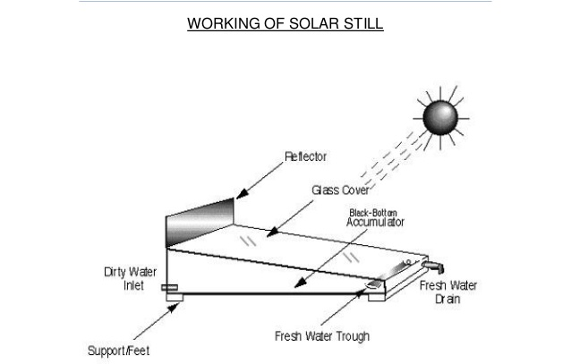
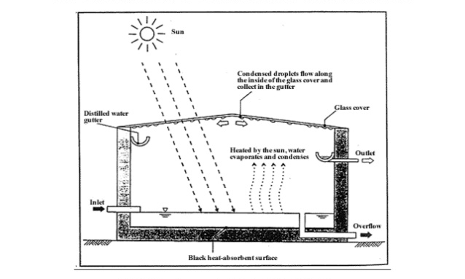
SOLAR BASED WATER PURIFIER

Slide 6
ABSTRACT
The purpose of this project is to design a water distillation system that can purify water from nearly any source,a system that is relatively cheap,portable and depends only any on renewable solar energy.
The Motivation for this project is the limited availability of clean water resources and the abundance of impure water available for potrntial coversion into potable water,In addition, there are many coastal locations where seawater is abundant but potable water is not available. Our project goal is to efficiency produce clean drinkable water from solar energy conversion.

Slide 7
INTRODUCTION
Water is basic necessity of man along with food and air.Fresh water resources usually available are rivers,lakes and underground water reservoirs.About 71% of the planet is covered in water,yet of oil of that 96.5%of the planets water is found in oceans 1.7%ground-water,1.7% in glaciers and the ice caps and 0.001% in the air as vapour and clouds,only 2.5% of the Earths’s water is freshwater and 98.8%of that water is in ice and ground water.Less than 1% of all fresh water is in rivers,lakes and the atmosphere.
Distillation is one of many processes available for water purification,and sunlight is one of several forms of heat energy that can be used to power that process.To dispel a common belief,it is not necessary to boil water to distill it.Simply elevating its temperature ,short of boiling ,will adequently increase the evaluation rate.

Slide 8
The still is filled each morning and evening.and the total water production for the dat is collected at that time.The still will continue to produce distillate after sundown until the water temperature cools down.Feed water should be added each day that roughly exceeds the distillate production to provide proper flushing of the basin water and to clean out excess salts left behind during the evaporation process.

Slide 9
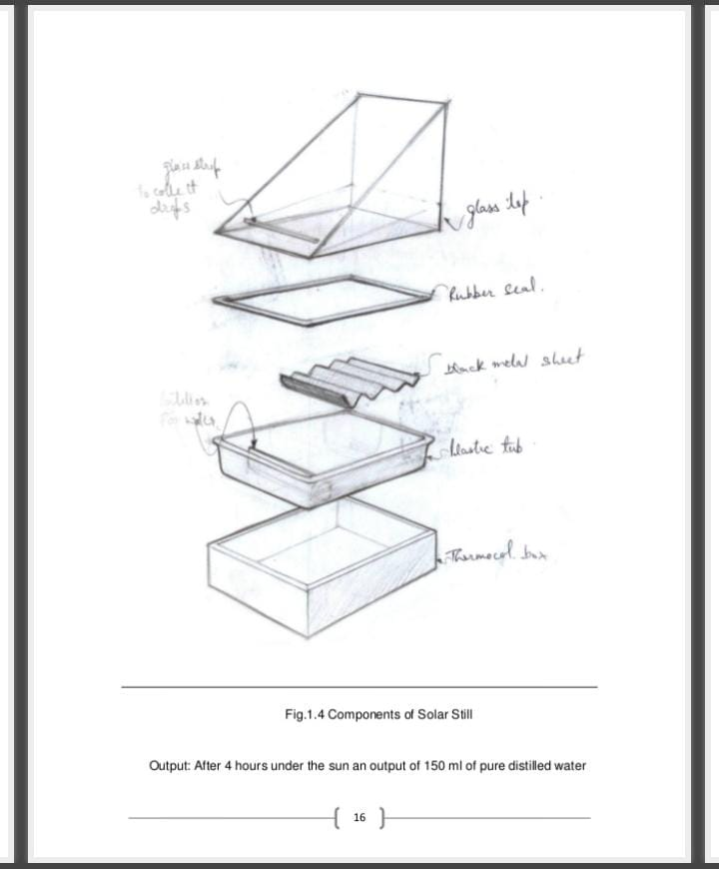
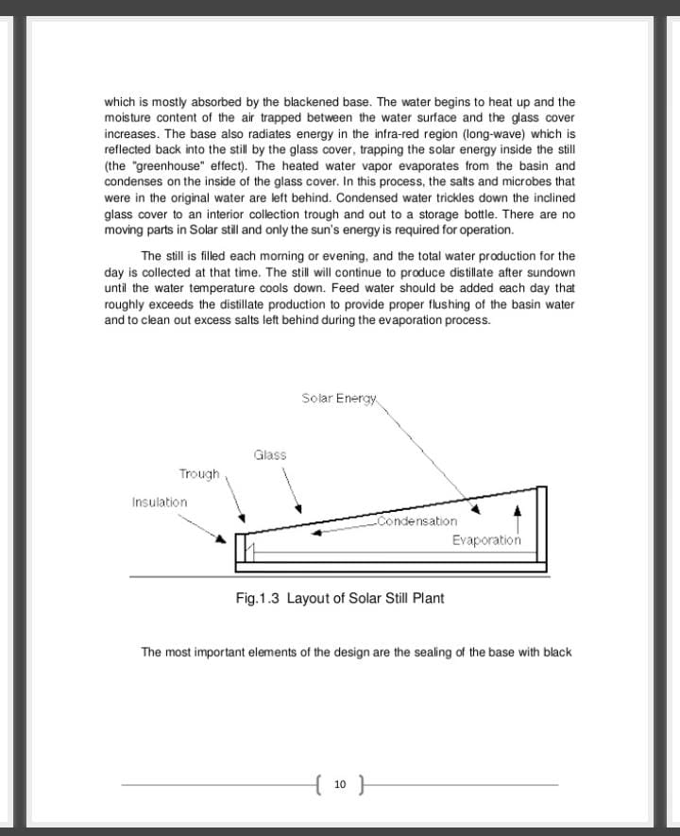
Design of project

Slide 10
WORKING
A solar has a top cover made of glass,with an interior surface made of a waterproof membrane.This interior surface uses a blackened material to improve absorption of the sun’s rays.Water to be cleaned is poured into the still to partially fill the basin.The glass cover allows the solar radiation to pass into the still,which is mostly absorbed by the blackened base.The water begins to heat up and the moisture content of the air trapped between the water surface and the glass cover increases.The base also radiated energy in the infra-red region which is reflected back into the the solar by the glass cover,trapping the solar energy inside the solar (the greenhouse effect).The heated water vapour evaporates from the basin and condenses on the inside the glass cover.In this process,the salts and microbes that were in the original water are left behind.Condensed water trickles down the inclined glass cover to an interior collection through and out to a storage bottle.There are no moving parts in solar panel and only the sun’s energy is required for operation.

Slide 11
Benefits of Distillation
It proudes water of high quality.
Maintenance is almost negligible.
Any type of water can be purified into portable water by means of this process.
Wastage of water will be minimum

Slide 12
COST ANALYSIS & MATERIAL
SR NO. | MATERIAL REQUIRED | COST OF MATERIAL (RS.)
1. | Aluminium Box | RS.2700
2. | Crushed hay & sawdust | Almost free
3. | Carbon black paint | RS.200
4. | Tempered glass | RS.800
5. | Reflector | RS.500
6. | Insulation and sealing | RS.250
7. | Labor and machining | RS.600
8. | Other equipment | RS.1000
TOTAL COST= |  | RS.6050

Slide 13


